Slide 1
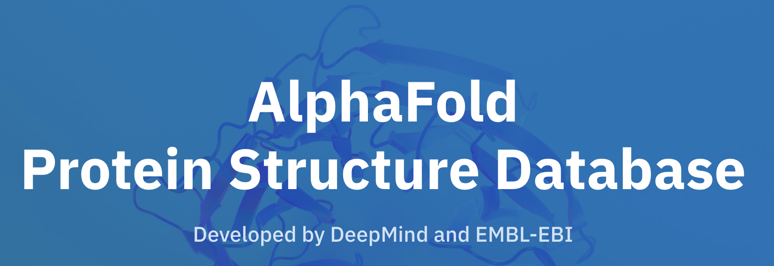
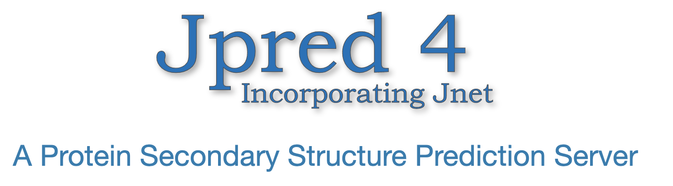
Predicting protein secondary structures: Jpred and Alphafold
Sophia Constantinou

Slide 2
Aims of project
Compare Jpred and Alphafold secondary structure predictions
Identify and try to understand the differences between them

Slide 3
What I’ve learned about Jpred
JPRED – online server:
Input: single amino acid sequence / MSA (multiple sequence alignment)
When the input is a single sequence PSI-BLAST searches in UniRef90 (iterative) generate a MSA
Then, using the MSA, generate profiles:
HMM profile from HMMer program
PSSM profile from PSI-BLAST
Feed the 2 profiles into Jnet
Output: 3-state secondary structure prediction with confidence score at each residue position
Notes:
JPred is an online server that mainly predicts the secondary structure of protein sequences, although it also predicts solvent accessibility, and coiled-coil regions
A user submits a single amino acid sequence or a multiple sequence alignment
The confidence score indicates the reliability for each residue and is as important as the prediction
So, when the input is a single sequence, PSI-BLAST takes that sequence, searches database and builds a profile,
and then searches that profile in database – iterative – gives a set of sequences that align to your query and capture variability at every position in the sequence
The set of related sequences are then aligned against the query sequence to generate a multiple sequence alignment
So, when you run jpred what happens is:
Step 1 – multiple sequence alignment
This step only applies if a user submits a single sequence
Step 2 – Generation of profiles
Using the multiple sequence alignment, an HMM profile is generated from the HMMer program, and a PSSM profile is generated from PSI-BLAST
Together, the two profiles are fed as input into Jnet
Step 3 – Prediction using Jnet

Slide 4
JNET
JNET – set of artificial neural networks (sequence-to-structure followed by structure-to-structure)
Inputs:
PSI-BLAST Position Specific Scoring Matrix (PSSM)
Hidden Markov Model (HMM) profile
Output: 3 nodes, average of HMM and PSSM
Data taken from SCOPe:
1 representative sequence taken from each superfamily
Filter data (low resolution, length, etc)
1507 sequences
Training data – 1348 sequences
Testing data (blind-test) – 149 sequences
7-fold cross validation performed on training subset
Compare with DSSP
Notes:
Jnet – set of artificial neural networks in 2 dimensions that has two profiles as inputs (PSSM and HMM):
one arm of Jnet accepts a PSSM profile as input, the other accepts an HMM profile as input
each arm is a sequence-to-structure neural net feeding into a structure-to-structure net
These nets have 3 output nodes, and the output of the sequence-structure network becomes the input for the structure-to-structure net
The prediction is the mathematical average of the output from the HMM net and PSSM net.
Data used to train Jnet:
Jnet is trained with annotated data from a database known as structural classification of proteins extended, or SCOPe
SCOPe is a hierarchical database of protein domains, where a domain is defined as a globular protein unit that has been experimentally determined to fold and exist on its own.
(Protein domains in SCOPe are classified into class, fold, superfamily and family.)
To train Jnet, 1 representative sequence was taken from each superfamily (987 representative sequences)
The following filtering steps were then applied to refine the data set:
Removing sequences whose corresponding structures had low resolution
Filtering by length. Sequences need to be long enough to fold as domains, but too long and PSIBLAST computation will take too much time
Domains made up of more than one polypeptide chain but are removed. There is no reason given but I think it is because multi-chain domains are made of super-secondary structures
Sequences were checked for pairwise redundancy using the AMPS algorithm with 100 randomizations. No such sequences removed
110 sequences which had missing secondary structure assignments in the DSSP database were excluded.
A few more sequences were manually removed giving us 1507 sequences for training and testing – unfortunately, some superfamilies are not represented in this dataset
The 1507 sequence dataset was divided into a training subset with 1348 sequences and a blind-test subset with 149 sequences
The training subset and blind-test subsets were chosen such that the percentage content of helix, sheet, and coil of the were within 1% of each other.
This produces a similar distribution of secondary structure compositions as training sequences to avoid biasing the reported accuracy of blind test results.
7-fold cross validation was performed on the training subset – divide data into 7, train on 6 and test on the other
The blind-test subset comprised of one representative each of 149 superfamilies not used in training
Accuracy assessed by comparison with DSSP information
DSSP – database of secondary structures extracted from crystal structures of protein domains on PDB (contains 8 states, reduce to 3 to train Jnet)
state H contains all types of helices, state E contains beta sheets, and all other is denoted as coils
Hello World
Hannah Fry

Slide 5
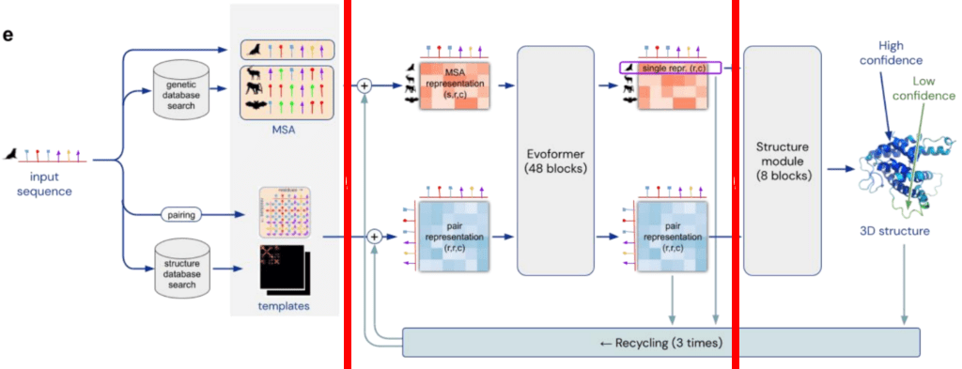
What I’ve learned about AlphaFold
Input: Single amino acid sequence
3 steps:
1) Construct MSA, “templates”, and “pair representation”
2) Pass them through Evoformer
3) Structure module
Notes:
Uses the input amino acid sequences to construct a MSA (multiple sequence alignment) by quering several databases of protein sequences
“templates” = tries to identify proteins that may have a similar structure to the input (conserved fragments)
”pair representation” = initial representation of the structure (in essence, a model of which amino acids are likely to be in contact with each other)
Transformer – identifies which pieces of information are more informative – refines representations for MSA and pair interactions, and iteratively exchanges info between them
A better model of the MSA will improve the network’s characterization of the geometry, which simultaneously will help refine the model of the MSA.
At every cycle, the model leverages the current structural hypothesis to improve the assessment of the multiple sequence alignment, which leads to a new structural hypothesis
Both representations, sequence and structure, exchange information until the network reaches a solid inference. (specified number of cycles)
Central idea – information flows back and forth throughout the network
Structure module - takes the refined “MSA representation” and “pair representation”, and uses them to construct a three-dimensional model of the structure.
Unlike previous models, this network does not use any optimisation algorithm: it generates a static, final structure, in a single step.
The end result is a long list of Cartesian coordinates representing the position of each atom of the protein, including side chains.
AlphaFold 2 finds similar sequences to the input, extracts the information using a neural network architecture, and then passes that information to another neural network that produces a 3D structure.
The model works iteratively – after generating a final structure, it takes all the information (MSA representation, pair representation and predicted structure) and pass it back to the beginning of the Evoformer blocks
Debbie Marks

Slide 6
Evoformer and structure module
Structure module:
Evoformer:
Every amino acid is modelled as a triangle, representing the three atoms of the backbone
Triangles float around and are moved by network
Transformations characterised by matrices
At every step of the iterative process, a set of matrices are produced that displace and rotate the residues in space
This representation does not reflect any physical or geometrical assumptions, and as a result the network has a tendency to generate structural violations
Uses “Invariant Point Attention” (IPA) – invariance to translations and rotations
Structure module also generates a model of the side chains
Define “embeddings” for the MSA and templates (discrete to continuous)
2 transformers, with one clear communication channel between the two
MSA transformer – computes attention over a large matrix of protein symbols
Attention is factorised in “row-wise” (computed first) and “column-wise” components
Horizontal attention mechanism incorporates information from the “pair presentation”
Pair representation head – works similarly, but attention is arranged in terms of triangles of residues
Notes:
(transform discrete variable to a continuous space so that the network can be trained)
Define a layer of neurons that receives the discrete input and outputs some continuous vector
Embeddings are vanilla dense neural networks (one hidden layer)
2) Each head is specialised for the particular type of data it is looking at (MSA or a representation of pairwise interactions between amino acids)
Horizontal - identifies which pairs of amino acids are more related
Vertical - determining which sequences are more informative

Slide 7
Guidance/Help needed
Unsure what Jia Geng was doing in the final part of his project
How to use Jia Geng’s code (keras, etc)
Unsure of how to approach the problem
Jia Geng used 451 domains that were used to train both Jpred and Alphafold – is there a way to use domains that are unknown to both Jpred and Alphafold?
Notes:
So, um I’ve looked at Jia Geng’s code, and I need some help deciphering what he’s done in the final part of his project, which was basically starting to compare the two
I’m not sure that this (what I’ve been reading) is relevant
Take a parasite?
Mapping of SCOPe domains used in training jpred
how do you find those in alphafold
generate secondary structure
run dssp on alphafold
Look at jpred training code -- run

Slide 8
References
Drozdetskiy A, Cole C, Procter J & Barton GJ. (first published online April 16, 2015) JPred4: a protein secondary structure prediction server, Nucleic Acids Res. Web Server issue
Cuff, J. A. and Barton, G. J. (2000) Application of Enhanced Multiple Sequence Alignment Profiles to Improve Protein Secondary Structure Prediction, PROTEINS: Structure, Function and Genetics 40:502-511
Author, Rubiera, C. O., & Rubiera, C. O. (2021, July 19). Oxford Protein Informatics Group. Retrieved July 7, 2022, from https://www.blopig.com/blog/2021/07/alphafold-2-is-here-whats-behind-the-structure-prediction-miracle/
Jie Geng’s presentations and code

